Slide 1


CAFE MANAGEMENT
SYSTEM
GROUP MEMEBER :
MANVI DAKSH
HARSH VERMA
MENTOR
PROF. R. N. PANDA
HARSH GUPTA
MAYANK KUMAR

Slide 2

INTRODUCTION
PURPOSE: STREAMLINE OPERATIONS AND ENHANCE CUSTOMER EXPERIENCES
Aims to develop a user-friendly cafe management system. The system will empower cafe owners to efficiently manage daily operations, track inventory, and optimize customer service.
Key Functions:
Inventory control
Sales tracking
Employee scheduling
Customer relationship management
Benefits:
Automates routine tasks
Provides real-time insights
Enables data-driven decisions
For stronger customer connections
Ensure operational excellence and sustainable growth in a competitive market

Slide 3

LITERATURE REVIEW
EXISTING CMS
The existing café management systems often rely on separate, disconnected applications for different functions, such as point-of-sale (POS), inventory management . These systems can lead to inefficiencies and communication gaps
Manual Order Processing:
Separate Inventory Tracking:
Challenges:
Inefficiencies: Manual processes are time-consuming and prone to errors.
Lack of Integration: Disconnected systems can lead to data inconsistencies and hinder operational efficiency

Slide 4

LITERATURE REVIEW
PROPOSED CMS
The proposed café management system aims to integrate all essential functions into a unified platform, enhancing operational efficiency and improving customer experience.
Integrated POS System: automates order processing and inventory updates in real-time.
Comprehensive Inventory Management:Advanced inventory tracking that automates reordering and provides alerts for low stock levels, reducing wastage.
Benefits:
Increased Efficiency
Improved Data Accuracy
Strategic Insights

Slide 5










OBJECTIVE
Aims to streamline operations and enhance efficiency within cafes.
Automate Processes
Optimize Inventory Management
Ensure Scalability
Customer experience
Streamline order management, inventory tracking, and billing to enhance operational efficiency.
Implement real-time tracking and stock alerts to minimize waste and prevent shortages.
Design the system to easily adapt to future growth and additional feature
Enable personalized interactions and faster service to improve customer satisfaction.

Slide 6

TECHNOLOGY
HARDWARE
SOFTWARE
Development Environment
Programming Language and Frameworks
Personal Computers/Laptops -
Minimum specifications:
Processor: Intel i5 or equivalent
RAM: 8 GB or more
Storage: 256 GB SSD or higher
JavaFX
For building the user interface of the Cafe Management System.
MySQL
For database management and storage of application data
Client Requirements
Development Tools
POS Terminals/Tablets
Minimum specifications:
Processor: Intel i3 or equivalent
RAM: 4 GB or more
Storage: 128 GB SSD or higher
Integrated Development Environment (IDE)
NetBeans or Eclipse: For JavaFX development.
Database Management Tool
MySQL Workbench: For designing and managing the MySQL database.

Slide 7



MODULE
INVENTORY MANAGEMENT
BILL GENERATION
LOGIN MODULE
Manages stock levels, tracks ingredient usage, and reordering to prevent shortages.
Creates detailed bills for customers, including itemized lists of orders, prices, and taxes.
Handles user authentication and access control for staff and administrators.

Slide 8



MODULE
MENU MANAGEMENT
REPORT MODULE
Provides insights into sales trends, inventory performance, and customer behavior to support data-driven decision-making.
Allows for easy updates to the menu, including pricing, descriptions, and item availability

Slide 9
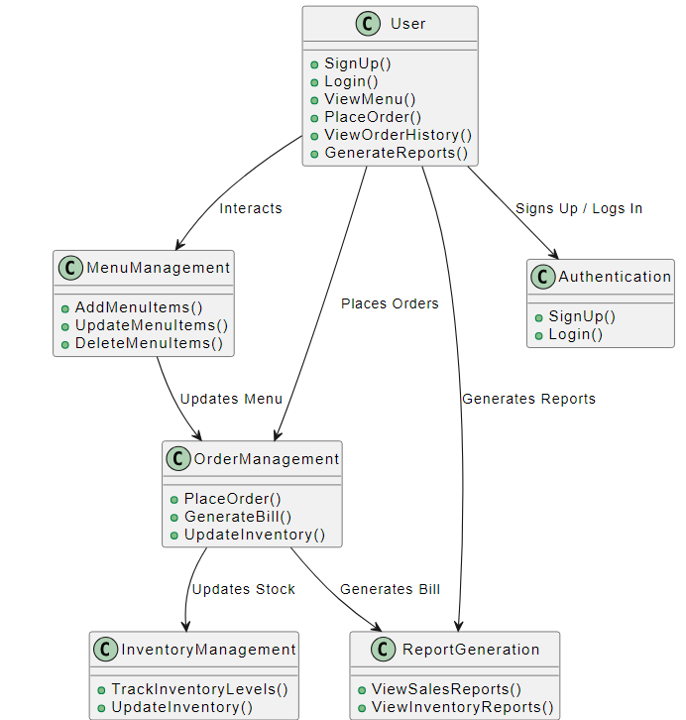
WORKFLOW

Slide 10
REFERENCE
National Restaurant Association - Website: www.restaurant.org
Toast - Website: www.toasttab.com
Oracle. (2023). JavaFX Documentation. Retrieved from openjfx.iom
MySQL. (2023). MySQL Documentation. Retrieved from dev.mysql.com

Slide 11
THANK YOU

